Slide 1



@careerins
Notes:
Edits (LB)
General - Takes a while to load as I think the images are quite large
This page – Logo and background image, is there something with a bit more contrast?

Slide 2



Slide 3

What can a career in insurance offer you?
Variety of work
Good pay
Opportunity to travel
Make a real difference in peoples lives
Be a part of a global industry
No matter what your skill set or education level, there is a place for you in insurance
Notes:
Changed fonts

Slide 4

HAVE YOU CONSIDERED A
CAREER IN INSURANCE?
Notes:
Thoughts on changing the text colour to teal not white?

Slide 5
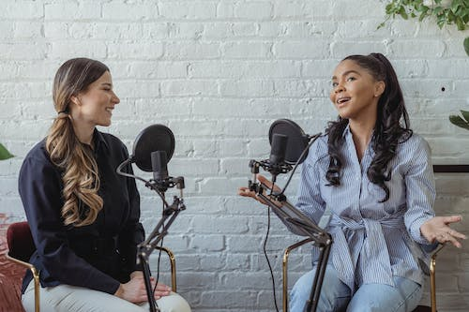


Find the role that best fits your personality.
Enterprising – “Persuader” You're a social people person, extroverted and proud!
Roles for you: broking, business development, human resources, marketing/communications, sales
Artistic – “Creator” You're full of creative energy, an innovator and imaginative.
Roles for you: actuary, marketing/communications, product development, sales
Social – “Helper” You love to support and help people, and find happiness doing so.
Roles for you: claims handling, customer service, human resources, loss adjusting

Slide 6



Find the role that best fits your personality.
Conventional – “Organiser” You thrive analysing, enjoy crunching the numbers and are results-oriented.
Roles for you: accounting/finance, actuary, information technology, underwriting and pricing
Investigative – “Thinker” You're curious and like to further research and investigate to solve problems.
Roles for you: accounting/finance, actuary, loss adjusting, risk management, risk surveyor
Realistic – “Do-er” You're a practical, hands-on and active person.
Roles for you: broking, risk management, risk surveyor, loss adjusting

Slide 7

DO ANYTHING.
WITH A CAREER IN INSURANCE

Slide 8
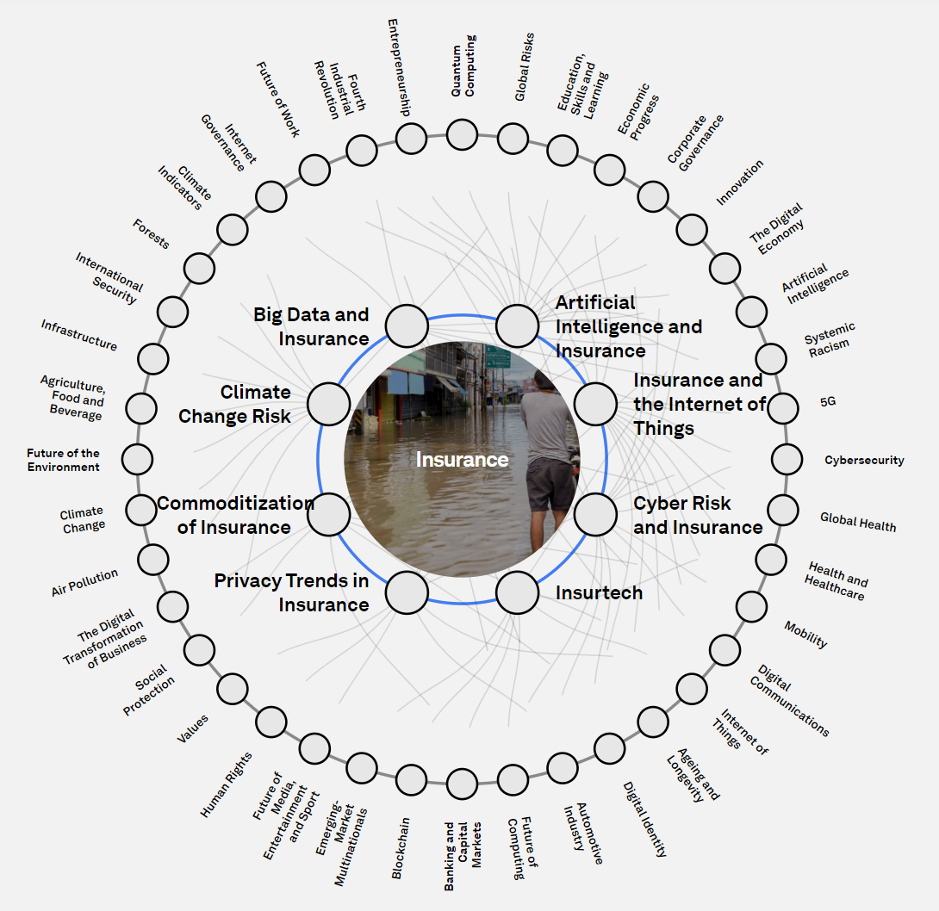
Follow your interests.
Here are some trending topics in insurance in 2023.

Slide 9
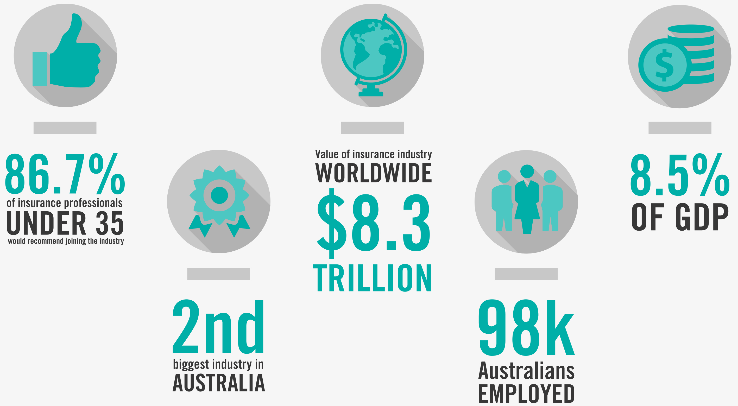
What does the research tell us?

Slide 10
Qualifications of professionals in the industry

Slide 11
We asked insurers ‘do you still want to be in the industry in 5 years?’

Slide 12
Young role models
leading the way
@careerins

Slide 13

Listen to Sam’s epic journey on careersininsurance.com.au now!
(Recently retired) Geelong Cats Midfielder, Sam Menegola, believes that the challenge of reaching your best but then staying your best applies equally to his football and insurance careers.

Slide 14

Listen to Kirsty’s story on careersininsurance.com.au now!
“Everyone ‘falls’ in it (insurance), but no one leaves, so we must be doing something right.”

Slide 15

LOOKING TO MAKE A REAL DIFFERENCE?

Slide 16
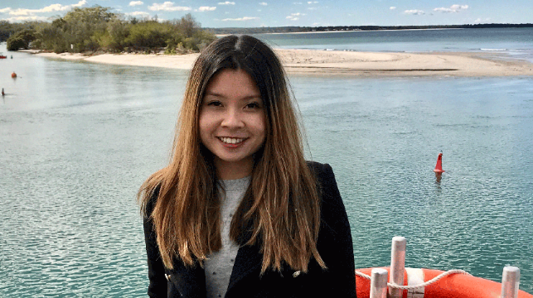
Making a Difference in insurance
“I knew that the skills I developed during my degree were highly transferrable, so I started looking for jobs that would fit my passion for helping others, learning, critical thinking, empathy and problem-solving,”
Sara Rusdiah - Strata Underwriter

Slide 17

GO ANYWHERE.
WITH A CAREER IN INSURANCE

Slide 18
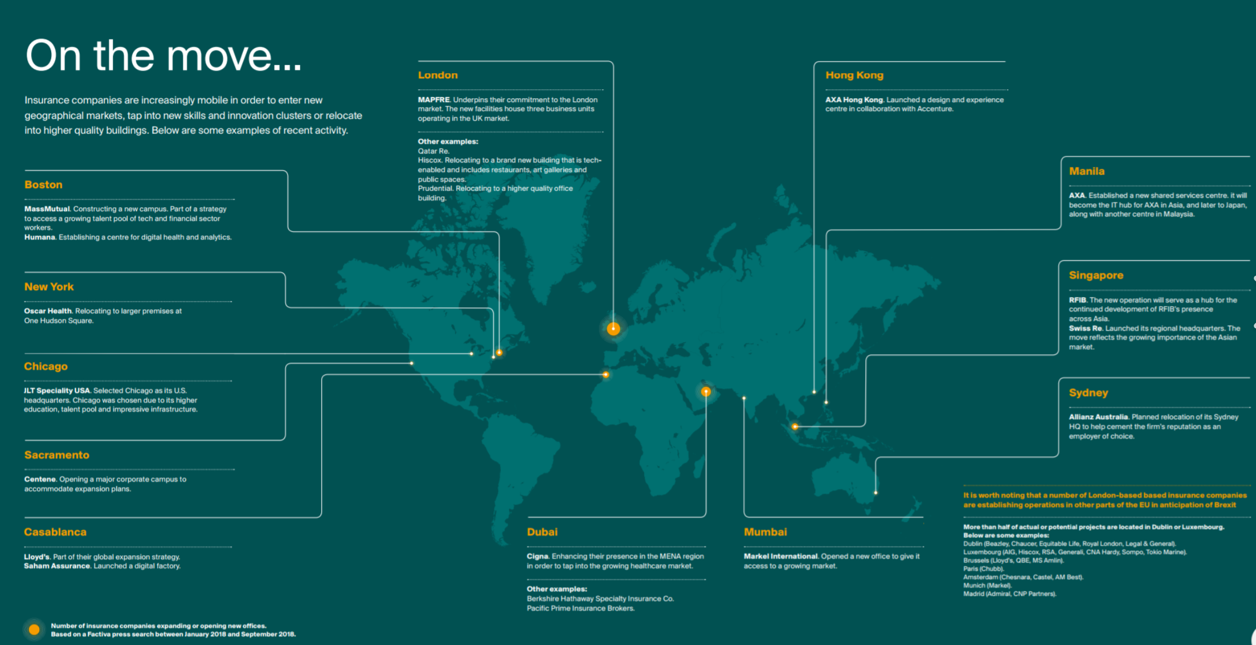
Once you have the skills you can take them
with you anywhere across the globe

Slide 19

Work for the companies building the insurance industry of the future

Slide 20
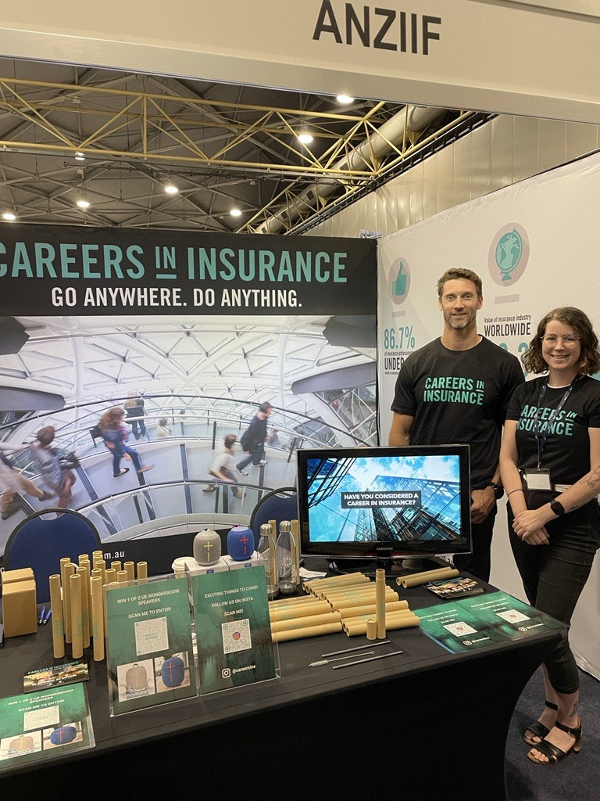
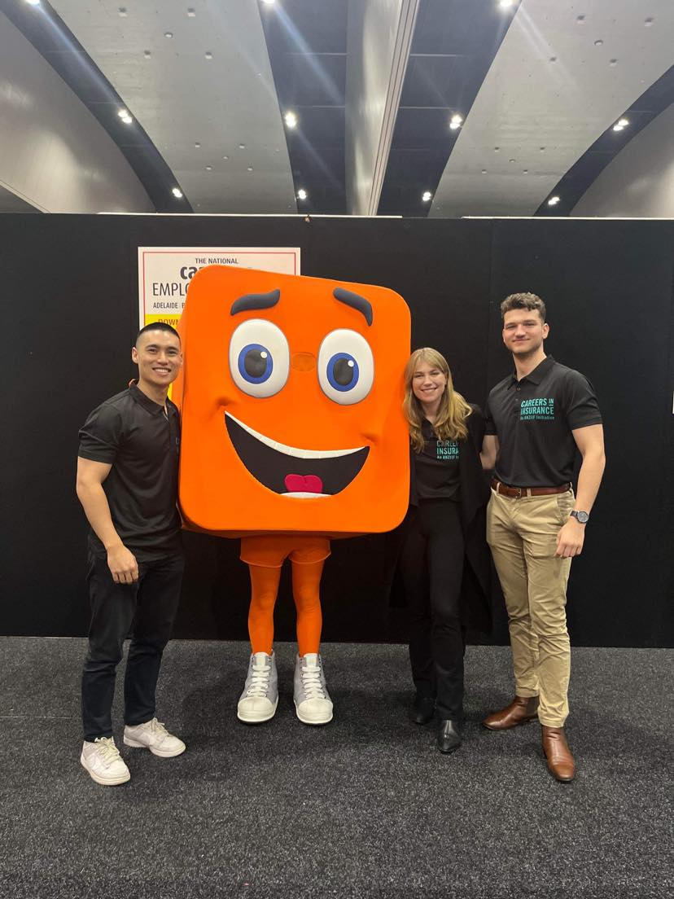
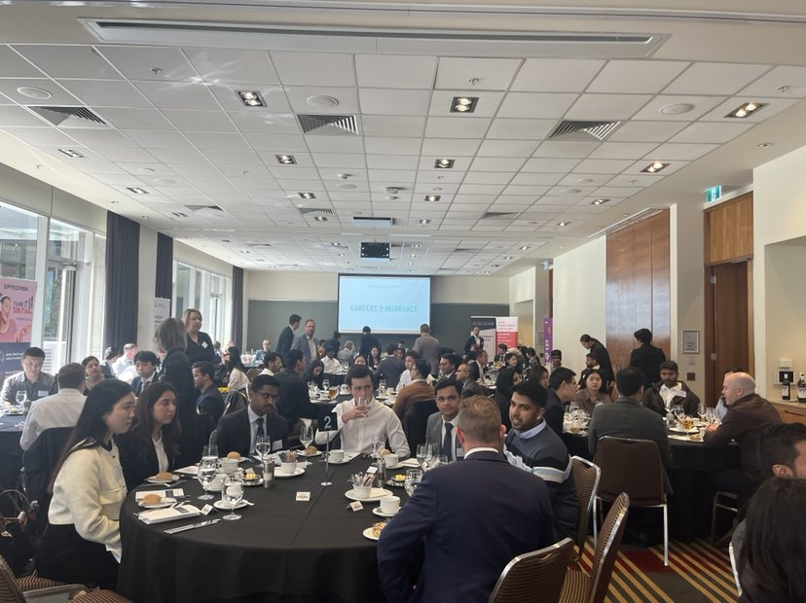
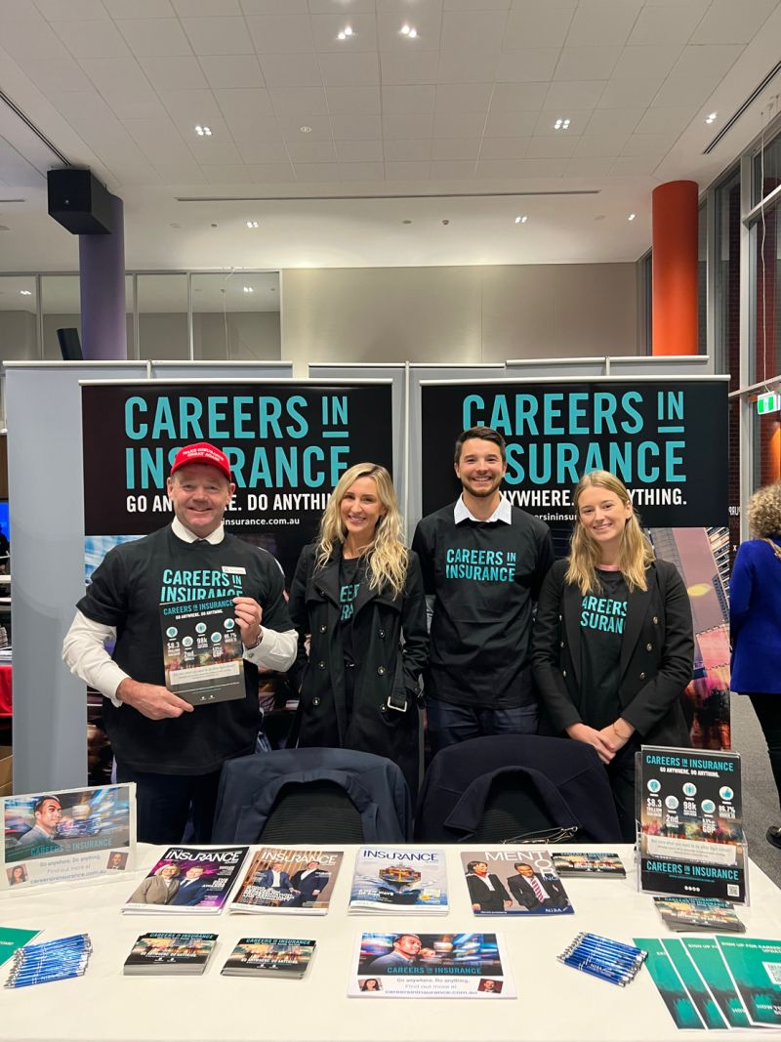
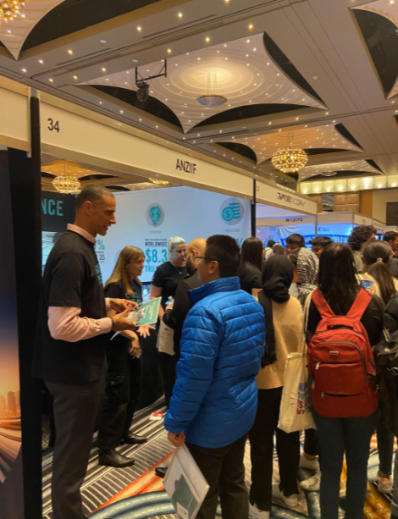
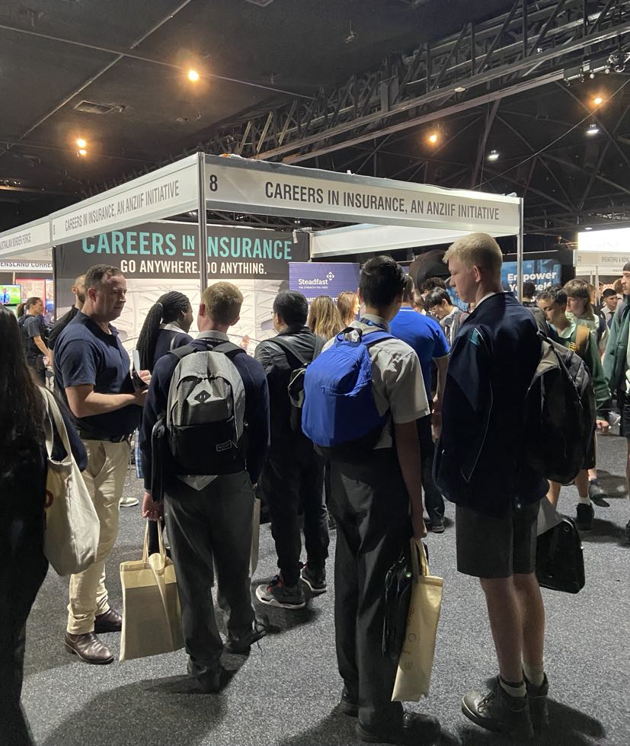
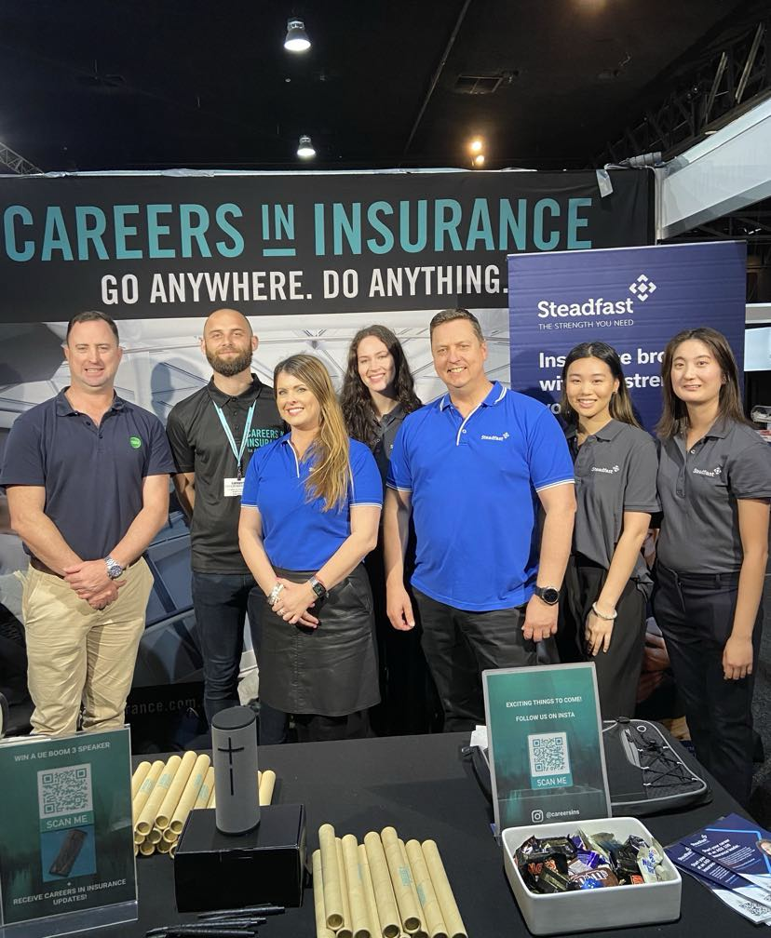
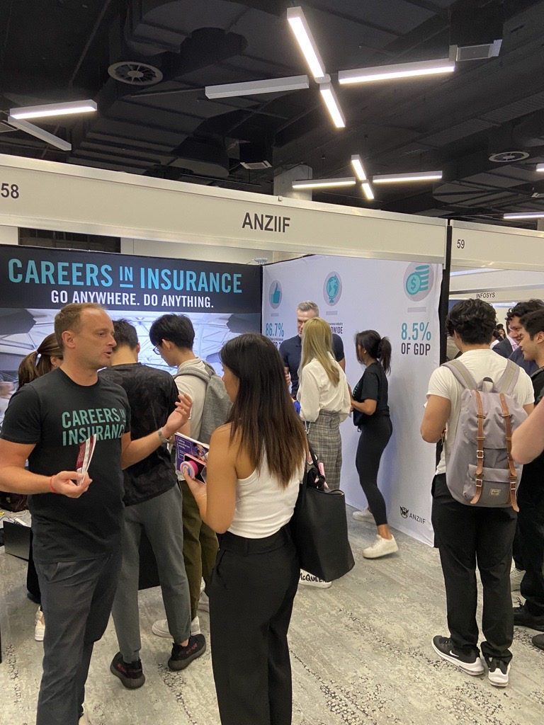

Slide 21


EXCITING THINGS TO COME FOLLOW US ON INSTA!
@careerins
Notes:
Could we add a QR code for the lead gen form on another page or is that too much?

